Slide 1
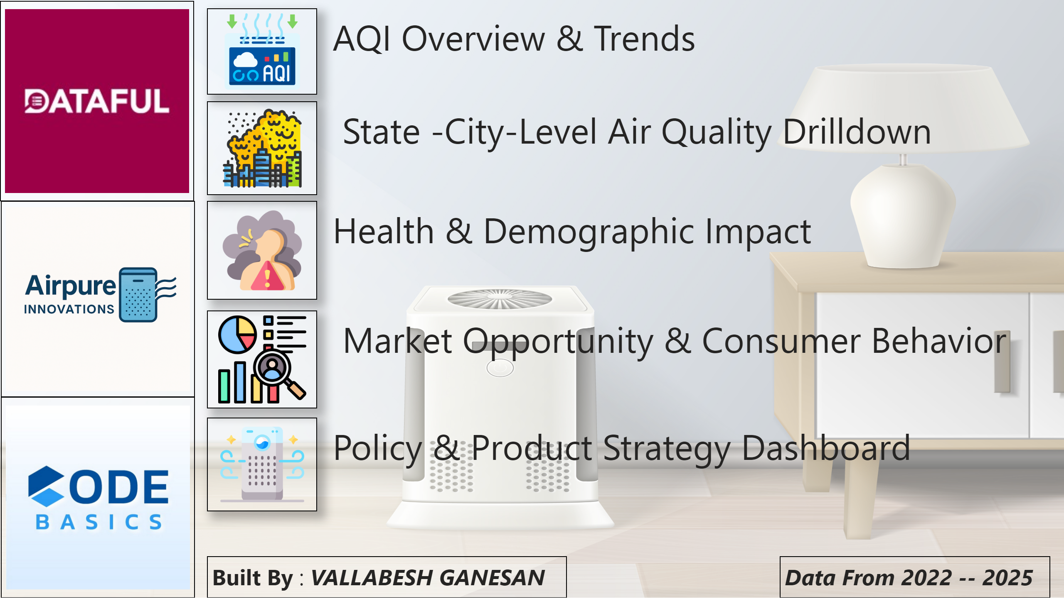
Home Page
Notes:
image
No alt text provided
image
No alt text provided
image
No alt text provided
image
No alt text provided
image
No alt text provided
image
No alt text provided
image
No alt text provided
image
No alt text provided
textbox
No alt text provided
textbox
No alt text provided
textbox
No alt text provided
textbox
No alt text provided
textbox
No alt text provided
textbox
No alt text provided
textbox
No alt text provided

Slide 2
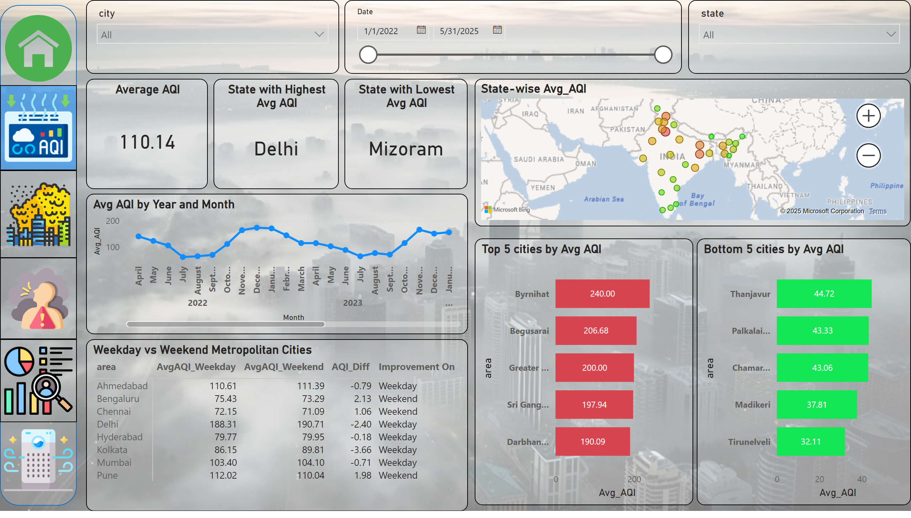
AQI Overview & Trends
Notes:
State-wise Avg_AQI
No alt text provided
slicer
No alt text provided
slicer
No alt text provided
shape
No alt text provided
Weekday vs Weekend Metropolitan Cities
No alt text provided
Avg AQI by Year and Month
No alt text provided
slicer
No alt text provided
Top 5 cities by Avg AQI
No alt text provided
Bottom 5 cities by Avg AQI
No alt text provided
Average AQI
No alt text provided
State with Lowest Avg AQI
No alt text provided
State with Highest Avg AQI
No alt text provided
image
No alt text provided
image
No alt text provided
image
No alt text provided
image
No alt text provided
image
No alt text provided
image
No alt text provided

Slide 3
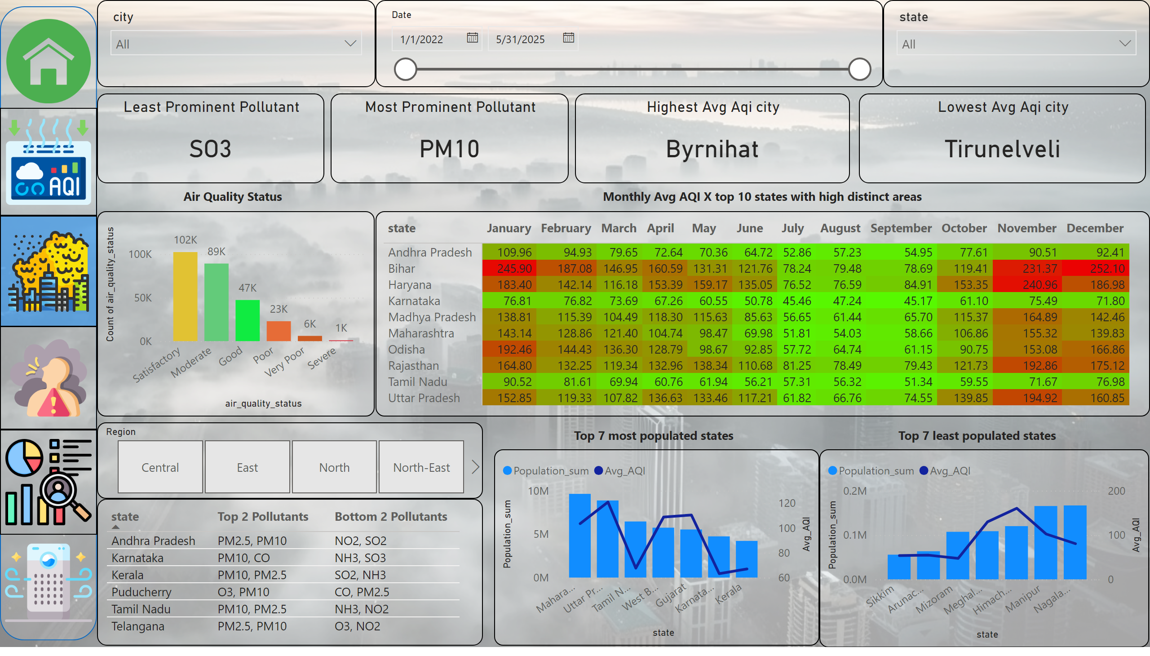
State -City-Level Air Quality Drilldown
Notes:
tableEx
No alt text provided
slicer
No alt text provided
pivotTable
No alt text provided
clusteredColumnChart
No alt text provided
slicer
No alt text provided
slicer
No alt text provided
slicer
No alt text provided
Top 7 most populated state
No alt text provided
lineStackedColumnComboChart
No alt text provided
textbox
No alt text provided
textbox
No alt text provided
textbox
No alt text provided
Highest Avg Aqi city
No alt text provided
Lowest Avg Aqi city
No alt text provided
Most Prominent Pollutant
No alt text provided
Least Prominent Pollutant
No alt text provided
textbox
No alt text provided
shape
No alt text provided
image
No alt text provided
image
No alt text provided
image
No alt text provided
image
No alt text provided
image
No alt text provided
image
No alt text provided

Slide 4
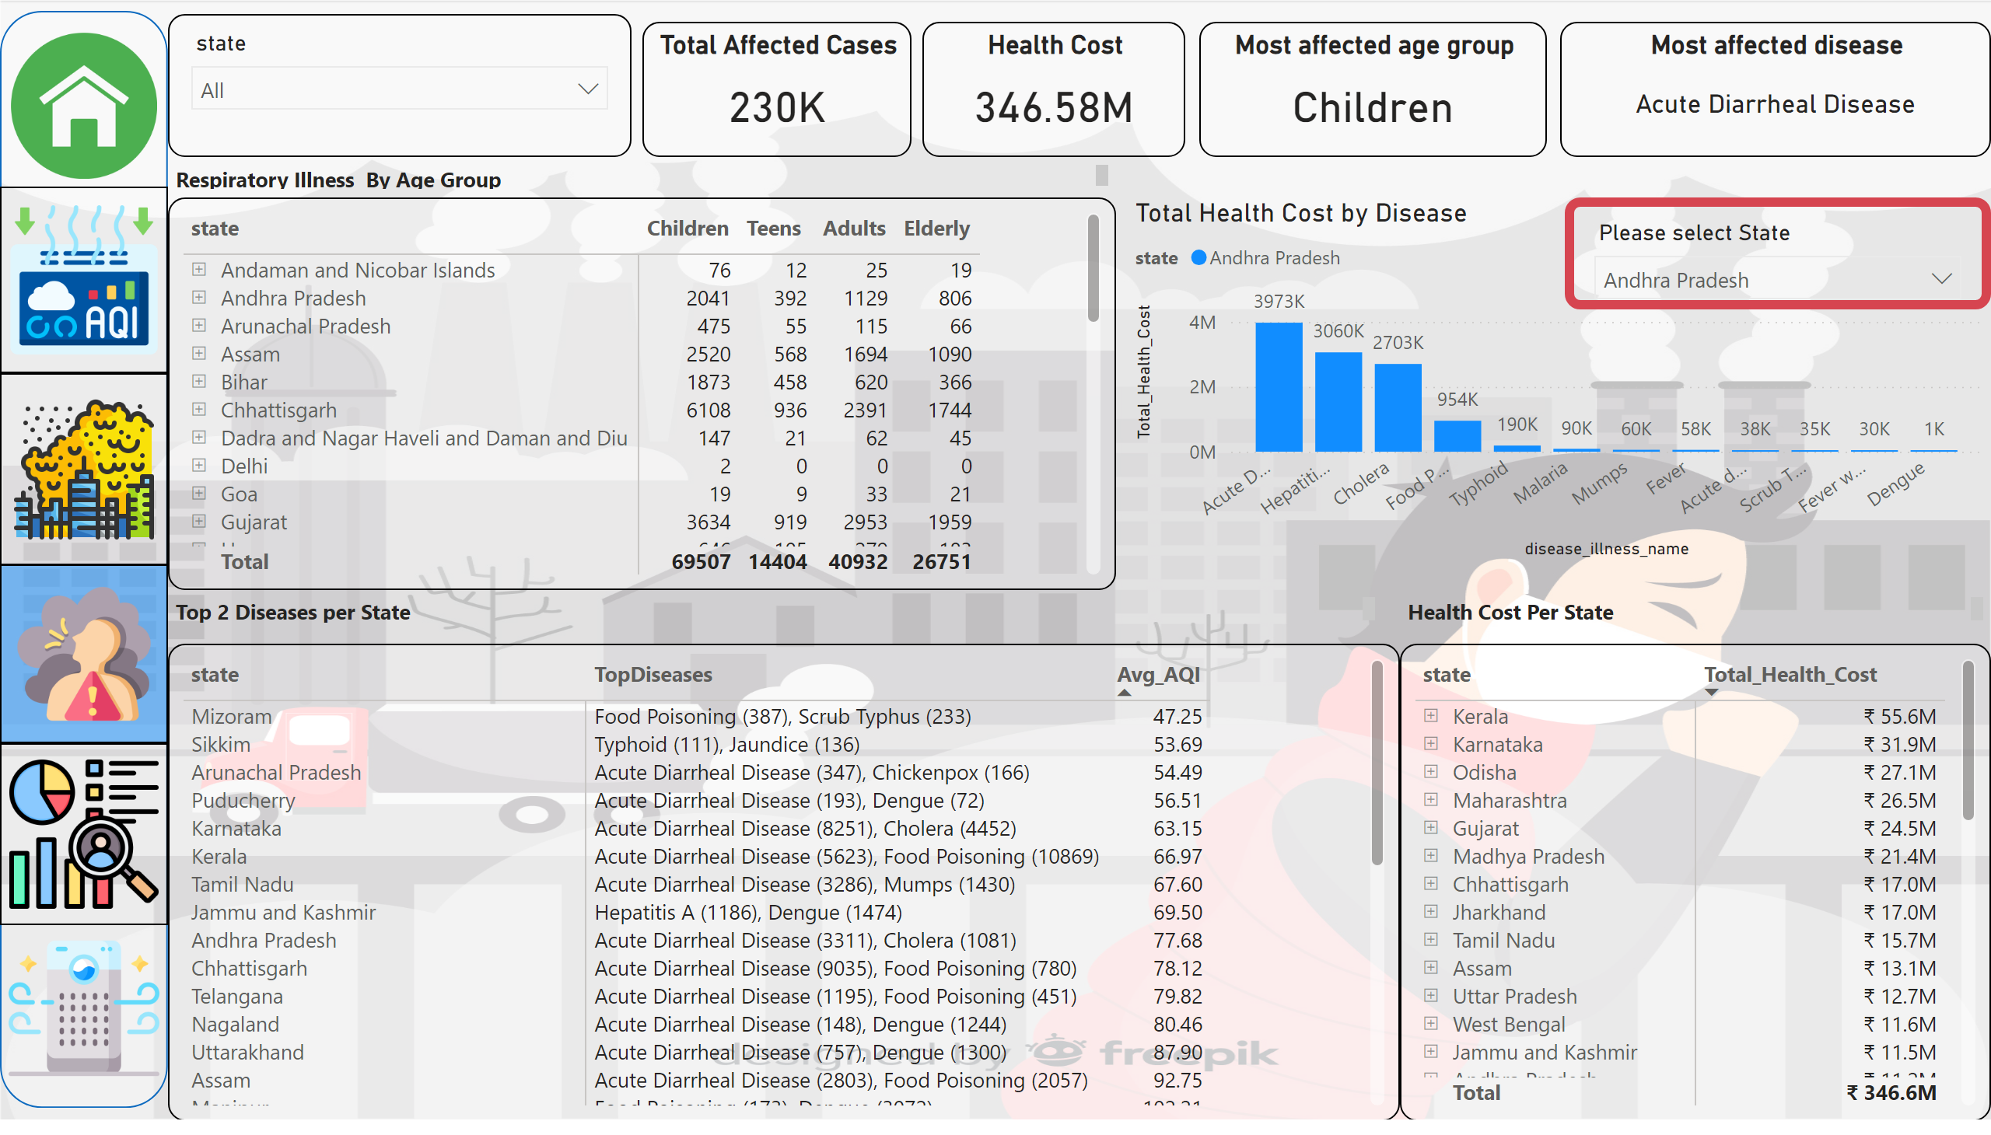
Health & Demographic Impact
Notes:
Total Health Cost by Disease
No alt text provided
Please select state
No alt text provided
pivotTable
No alt text provided
pivotTable
No alt text provided
pivotTable
No alt text provided
slicer
No alt text provided
Total Affected Cases
No alt text provided
Health Cost
No alt text provided
Most affected age group
No alt text provided
Most affected disease
No alt text provided
textbox
No alt text provided
shape
No alt text provided
image
No alt text provided
image
No alt text provided
image
No alt text provided
image
No alt text provided
image
No alt text provided
image
No alt text provided
textbox
No alt text provided
textbox
No alt text provided

Slide 5
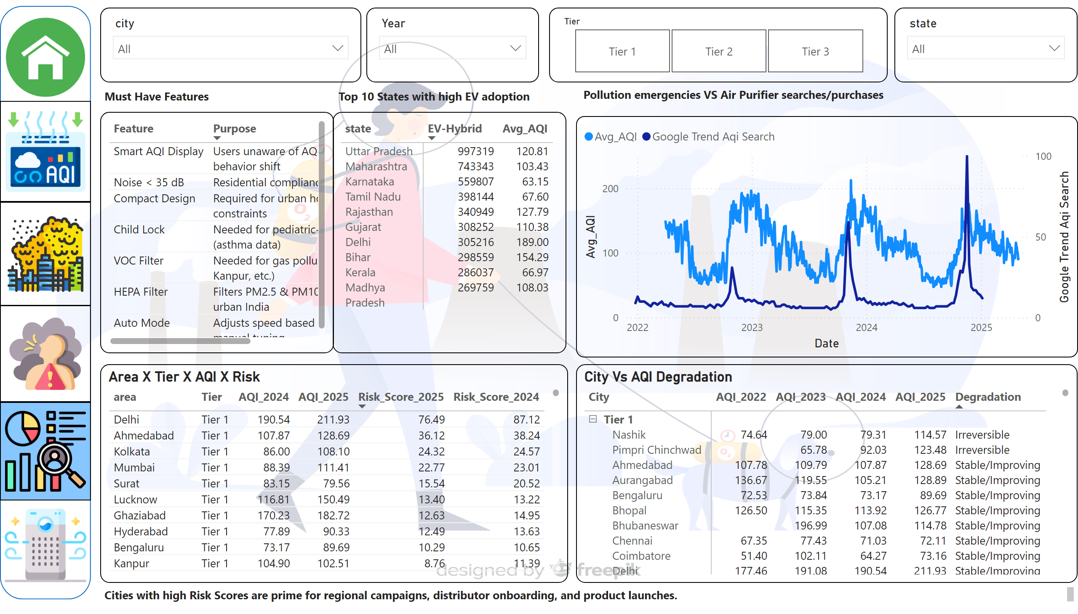
Market Opportunity & Consumer Behavior
Notes:
lineChart
No alt text provided
Area X Tier X AQI X Risk
No alt text provided
slicer
No alt text provided
City Vs AQI Degradation
No alt text provided
pivotTable
No alt text provided
slicer
No alt text provided
slicer
No alt text provided
slicer
No alt text provided
tableEx
No alt text provided
shape
No alt text provided
image
No alt text provided
image
No alt text provided
image
No alt text provided
image
No alt text provided
image
No alt text provided
image
No alt text provided
textbox
No alt text provided
textbox
No alt text provided
textbox
No alt text provided
textbox
No alt text provided

Slide 6
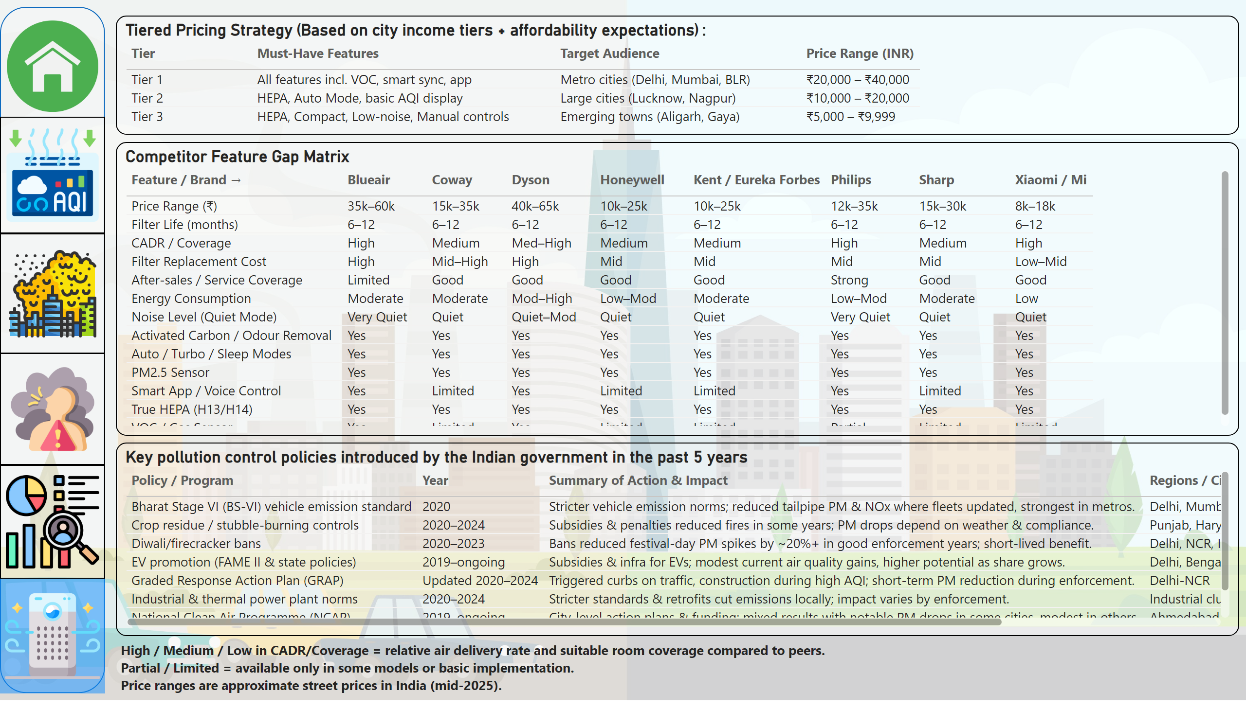
Policy & Product Strategy Dashboard
Notes:
Competitor Feature Gap Matrix
No alt text provided
Key pollution control policies introduced by the Indian government in the past 5 years
No alt text provided
Tiered Pricing Strategy (Based on city income tiers + affordability expectations) :
No alt text provided
shape
No alt text provided
image
No alt text provided
image
No alt text provided
image
No alt text provided
image
No alt text provided
image
No alt text provided
image
No alt text provided
textbox
No alt text provided

Slide 7
How aware are Indian citizens of what AQI (Air Quality Index) means — and do they understand its health implications?
General awareness that air pollution is harmful is high.
However, technical understanding of AQI and its health significance is quite low, especially beyond the term itself.
Most people haven’t noticed local air quality monitors, and haven’t seen LED AQI displays.
While most recognize pollution harms health, few can link specific pollutants to diseases; behavior change is minimal.
Information is often technical and not action-oriented; most people don’t get clear guidance on what to do on bad AQI days
Public sentiment shows apathy and frustration ,many dismiss AQI concerns or treat them humorously, even during severe pollution events.

Slide 8
Health Burden: How do AQI spikes correlate with pediatric asthma admissions?
Yes, spikes in the Air Quality Index (AQI), indicating higher levels of air pollution, can significantly impact pediatric asthma patients. Increased air pollution, especially from traffic-related sources, can trigger asthma flare-ups, leading to more frequent symptoms, increased medication use, and potentially more emergency room visits or hospitalizations.
International studies show AQI or pollutant spikes (e.g., PM₁₀, NO₂) are strongly associated with immediate increases in asthma morbidity and hospital visits, both on the day of exposure and up to two days later

Slide 9
Feature Gap: What do existing products lack (e.g., smart AQI syncing, compact designs)?
Most models rely only on built-in PM2.5 sensors; very few can pull real-time outdoor AQI data and adjust operation proactively.
No health-profile-based modes (e.g., pediatric, elderly sensitivity).
Multi-gas sensors (for VOCs, NO₂, O₃) are typically restricted to premium imports; mid-range models rarely have accurate gas monitoring.
Filter life indicators vary in accuracy; replacement filters for many brands are costly and not always available locally.
After-sales service coverage outside metros is weak for many premium brands, limiting uptake in expanding non-metro markets.
Apps and onboard controls are often English-only; no widespread multi-language support to aid broader user adoption.

Slide 10
AirPure isn’t just an air purifier — it’s a commitment to cleaner, healthier living. By combining advanced filtration, smart AQI syncing, and a compact design built for Indian homes, AirPure ensures every breath you take is fresh, safe, and full of life. Thank You

